Slide 1
STUDY WITH PURPOSE
MAIR Curriculum
BA/MA Student Session April 2024
Washington, DC Ι Nanjing, China Ι Bologna, Italy

Slide 2
Office of Academic Advising
Brian McEntee
Jaime Warren
Marie Gorman
What we do: Course Planning and Registration, Curriculum Questions, Long-term Planning, Requirements Tracking and Degree Clearance, Academic Policies and Procedures, and Academic Support and Resources

Slide 3
Degree Overview
Master of Arts in International Relations (MAIR)
2 year full-time (fall/spring) in-person program Optional summer courses 64 credits 16 credits/semester + non-credit language course (if needed) Same requirements for students who start in Washington, DC or at SAIS Europe At least 3 full-time semesters required; at least 1 full-time semester must be spent in Washington, DC

Slide 4
Degree Sequence
Year 1
Year 2

Slide 5
Curriculum Overview
Core Curriculum
Leadership, Ethics, and Decisionmaking World Order and Disorder International Economics (2 courses) | Research Methods Statistics for Data Analytics
Self-Designed Program of Study
Functional Focus Areas Development, Climate, and Sustainability International Economics and Finance Security, Strategy, and Statecraft Governance, Politics, and Society Technology and Innovation | Regional Focus Areas Africa The Americas Asia China Europe and Eurasia The Middle East United States
Other Degree Requirements
Capstone Language Proficiency Non-Credit Professional Development Skills Courses

Slide 6
Core Curriculum
Methodological Foundations and Big Picture Thinking
6 courses/24 credits
Leadership and Decision-making in International Relations
Leadership, Ethics, and Decision Making or American Foreign Policy Since WWII or Comparative Politics
World Order and Disorder
Theories of International Relations or Evolution of the International System
International Economics (2 courses)*
International Economics I or Essentials of International Economics I International Economics II or Essentials of International Economics II
Research Methods
Sample courses: Econometrics, Applied Econometrics, Macro Econometrics, Theories & Methods of Qualitative Political Research, Practical Research Methods, Research Design and Causal Inference and more
Statistics for Data Analytics*
* Passing a waiver exam allows student to replace a requirement with a more advanced course

Slide 7
Outright Waivers
Homewood Course | SAIS Equivalent | Next Steps
International Trade (AS.180.241) | International Economics I (IE I) | Pass SAIS Replacement Economics course to satisfy IE I Core
International Monetary Economics (AS.180.242) | International Economics II (IE II) | Pass SAIS Replacement Economics course to satisfy IE II Core
Statistical Analysis (EN.550.111,EN.553.111)* | Statistics for Data Analysis | Fulfills Data Analytics Core Must pass 2nd Research Methods Core (total 8 cr.)
Econometrics (AS.180.334) | Econometrics | Pass a different Research Methods Course (to satisfy RM Core)
SAIS does not accept transfer courses or credits from JHU or other institutions
*Approved Statistics courses: AS.230.205, AS.280.345, EN.550.111, EN.550.420/430, EN.553.111/112/211/310/311, EN.553.420/430, EN.560.348
Notes:
Many of you have completed undergraduate level economics and statistics courses at the Homewood campus. These courses don’t fulfill or waive SAIS requirements, but they can be used to take more advanced economics courses at SAIS. We offer Outright waivers for the following courses if students:
Receive a grade of B- (S*) or better in the economics/statistics course AND
Have completed the Homewood within last 5 years
Econ waived – Students must replace the IE I/II waived courses with a 4 cr. SAIS Int’l Economics & Finance courses
Stats waived - Students who waive Statistics must complete a total of 8 cr. of Research Methods courses
SAIS no longer offers Micro and Macroeconomics, so the JHU Microeconomic Theory and Macroeconomic Theory courses do not apply to the MAIR degree and do not qualify for Outright waivers.
SAIS does not accept transfer courses or credits from JHU or other institutions so there is not an option to waive Theories of IR (for example) with an exam or a Homewood course. Students must complete the MAIR requirements by passing SAIS courses. In addition, your Homewood language courses won’t fulfill the proficiency requirement, but you can take the language placement test to determine if you are immediately eligible to take the SAIS proficiency exams.

Slide 8
Self-Designed Program of Study
Interdisciplinary Approach
10 courses/40 credits
Focus Areas
Functional Focus Areas Development, Climate, and Sustainability International Economics and Finance* Security, Strategy, and Statecraft Governance, Politics, and Society Technology and Innovation | Regional Focus Areas Africa The Americas Asia China Europe and Eurasia The Middle East United States
Expand Your Expertise
Students must complete: at least 3 courses from 1 Functional Focus Area at least 3 courses from 1 Regional Focus Area
*Students who wish to pursue this focus area must complete or waiver International Economics I and II

Slide 9
Focus Area Combinations: 3 Examples
International Economics and Finance+ The Americas
Economic Development
Multinational Corporate Finance
Economics of Immigration
International Political Economy of Emerging Markets
Financial Crises and Policy Dilemmas in Emerging Markets and Latin America
Understanding Modern Latin American Politics
Security, Strategy, and Statecraft + China
Strategy and Policy
Kissinger Seminar: History, Strategy, and American Statecraft
American Intelligence: Role and Practice
China's National Security Perspectives
Chinese Foreign Policy
Asian Maritime Interests and Strategies
Development, Climate, and Sustainability + Africa
Renewable and Distributed Energy Policy
Climate Change, Science Economics, and Politics
Geopolitics of Energy
Political Economy of African Development
Energy, Politics, and Development in Africa
Contemporary African Politics
Notes:
Every student is different. Has different background. Has different goals. How you might combine your interests THESE ARE JUST SAMPLES NOT RECOMMENDATIONS.

Slide 10
Sample 2 Year Plan
First-Year Fall
World Order and Disorder
International Economics 1 or 2
Statistics for Data Analytics
Functional Focus Area
Non-Credit Language Course
First-Year Spring
Leadership, Ethics & Decisionmaking
International Economics 1 or 2
Functional Focus Area
Regional Focus Area
Non-Credit Language Course
Second-Year Spring
Regional Focus Area
Capstone or Elective
Elective
Elective
Non-Credit Language Course
Four 4-credit courses + one non-credit language course each semester
Second-Year Fall
Research Methods
Functional Focus Area
Regional Focus Area
Capstone or Elective
Non-Credit Language Course
First Year: at least 4 of 6 Core courses
Second Year: remainder of focus area courses, electives, and capstone

Slide 11
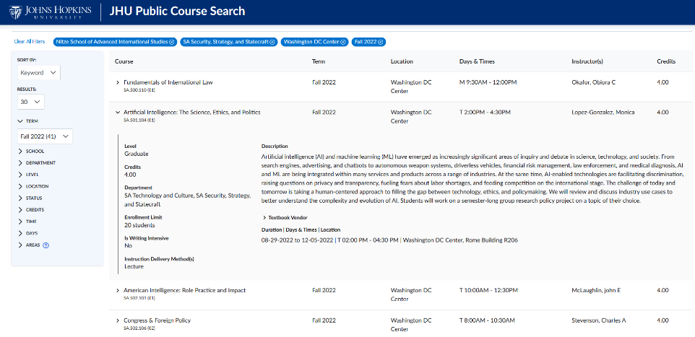
Public Course Search
https://courses.jhu.edu

Slide 12
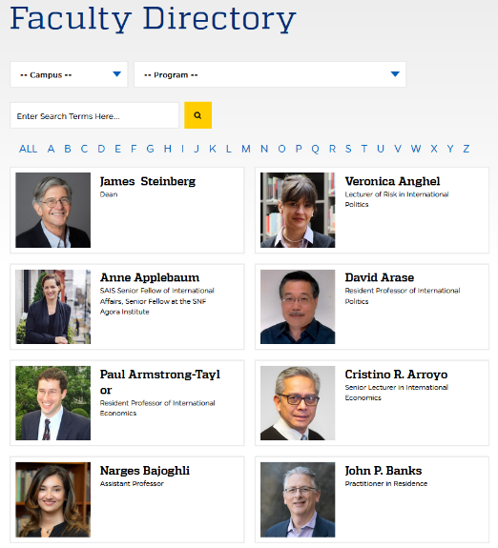
Faculty Directory
https://sais.jhu.edu/faculty-research

Slide 13
Language Proficiency
Language Proficiency Requirement
Students must demonstrate proficiency in a non-native language by passing proficiency exams SAIS offers language courses (non-credit) to help students prepare for proficiency exams; included in full-time tuition Possible to reach proficiency in a new language within 4 semesters of full-time study Non-native English speakers* may use English as their proficiency language
*Since English is of medium of instruction, non-native English speakers must take a diagnostic test to determine they have sufficient language skills and may be required to enroll in additional English language courses if not

Slide 14
Language Courses
Both Campuses | Washington DC Only | SAIS Europe Only*
Arabic English French Russian Spanish | Chinese Indonesian Japanese Korean Persian (Farsi) | German Italian Portuguese
*Students who begin instruction in these languages at SAIS Europe may continue with virtual instruction after they transition to Washington, DC campus.

Slide 15
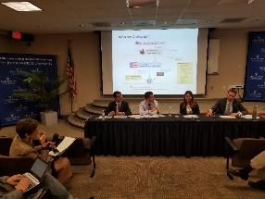
Experiential Learning
Capstone Options (Second Year)
Students must complete 1: Practicum Course Study Trip Course Research Seminar Course Expanded Research Paper (non-credit) Approved Internship Research Paper (non-credit)
Non-Credit Professional Skills Courses
Students must complete 2: Beginner, Intermediate and Advanced Excel Introduction to R Introduction to Tableau Corporate Valuation Introduction to Intelligence Analysis Business Lessons in Leadership Writing Skills for a Policy Career Preparing and Delivering a Briefing and many more…

Slide 16
Sample Capstone Courses in 2022-2023
Practicum Courses
Energy & Environment Practicum International Development Practicum SAIS Women Lead Practicum Central Asia Practicum International Human Rights Law Clinic National Security and Emerging Technology Practicum Technology and Geopolitical Risk Practicum
Study Trip Courses
Technology and Security in Asia: India Study Trip US-Japan Relations in a Global Context International Staff Ride Leadership Seminar Conflict Management Field Trip Latin American Research Seminar and Study Trip
Research Seminars
Advanced Topics in Chinese Foreign Policy: China at the Borders Political Economy in the Shadow of Conflict Strategic Studies Research Seminar

Slide 17
Semester Exchange
Notes:
Can participate in fall semester exchange but should consider how it will impact enrollment in 3 SAIS semesters
Reduced to 1 fall and 2 spring semesters. Think about fall/spring only courses
Exchange courses don’t fulfill SAIS requirements.
Not feasible to fit elective courses in 3 terms occupied by all requirements
No room for 2 semester capstones
Not eligible to pursue dual degree and cannot take LOA. Must complete the MAIR in 5 consecutive semesters per BA/MA agreement.

Slide 18
Summer Preparation
Online Principles of Economics (OPE)
Introductory course in Microeconomics and Macroeconomics Fulfills MAIR economics entry requirement 9 weeks fully online; asynchronous
Pre-Term
Optional hybrid (virtual + in-person) program prior to the start of the fall semester Acclimate to campus, meet fellow students, improve skills and fulfill requirements Washington, DC: Statistics and English SAIS Europe: Statistics, English, and Survival & Intensive Italian

Slide 19
Learn More
Questions?
Questions?
Questions?
Office of Academic Advising
(Washington, D.C.)
saisadvising@jhu.edu

Slide 20
Transitioning to SAIS – What to Expect
Onboarding Process
Matriculate to SAIS in mid-May Gain access to SAIS systems Receive welcome message and checklist from SAIS Advising Review Canvas and SAIS Portal pages Group Advising Sessions Academic preparation and planning resources Available Support (Advising, Faculty, Student Life, SEAM)
registration
Review past syllabi and evaluations Registration process Different timelines for SAIS DC and SAIS Europe Waitlists
Additional Considerations
Visas for int’l students and SAIS Europe Pre-Term and/or summer course registration Financial Aid and Housing

