Slide 1
Planned Academic Program Worksheet
USACC FORM 104-R
“Train to Lead”

Slide 2
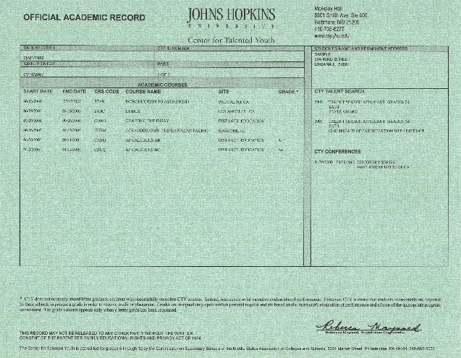
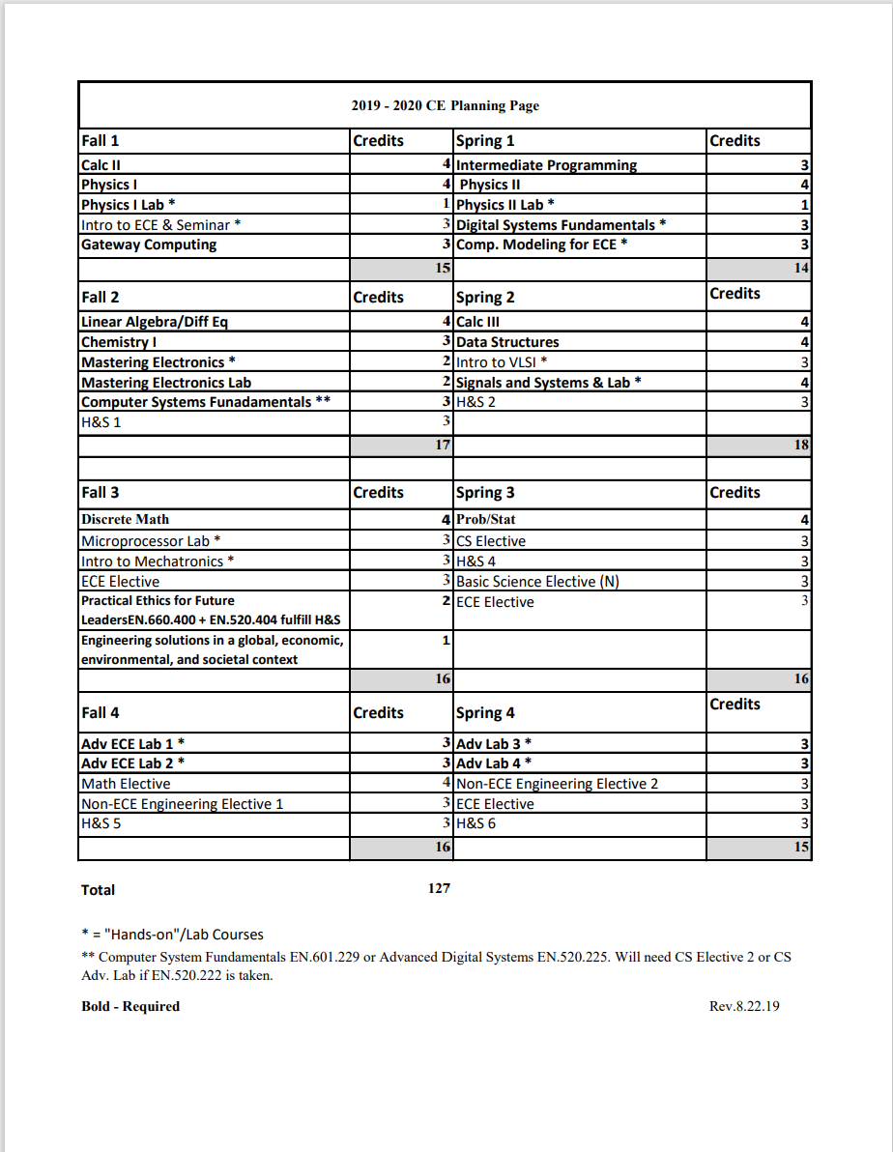
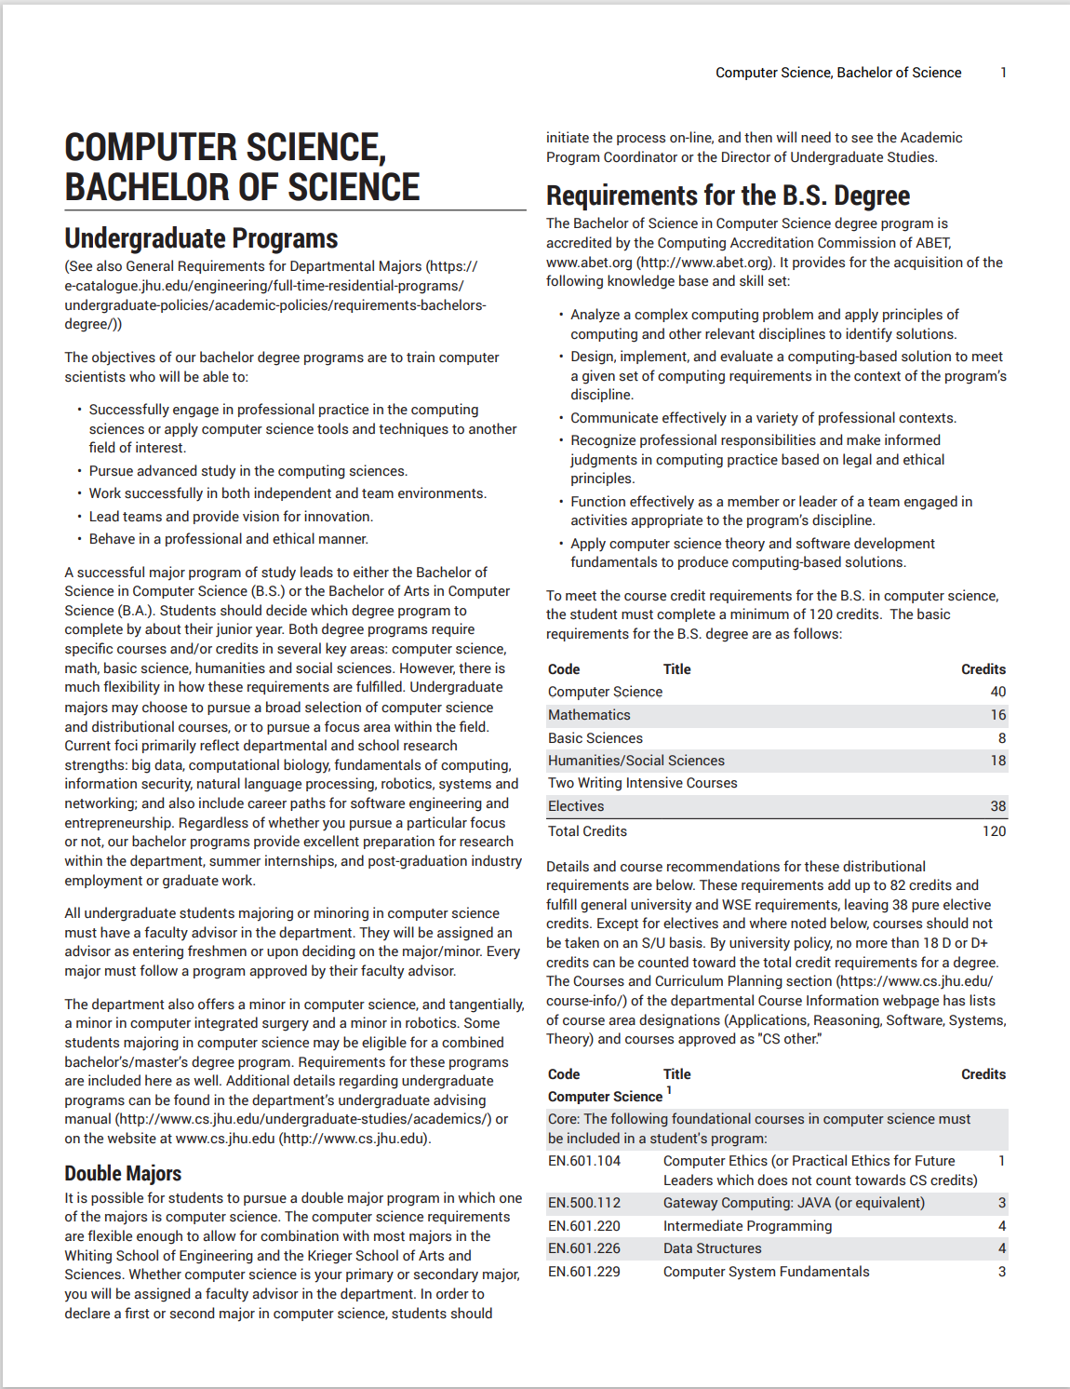
What we need to start (Hopkins)
- Blank 104-R dated SEP 2013
- Current transcript
- Degree audit worksheet and/or
- Course Catalogue Degree Requirement printout
“Train to Lead”

Slide 3
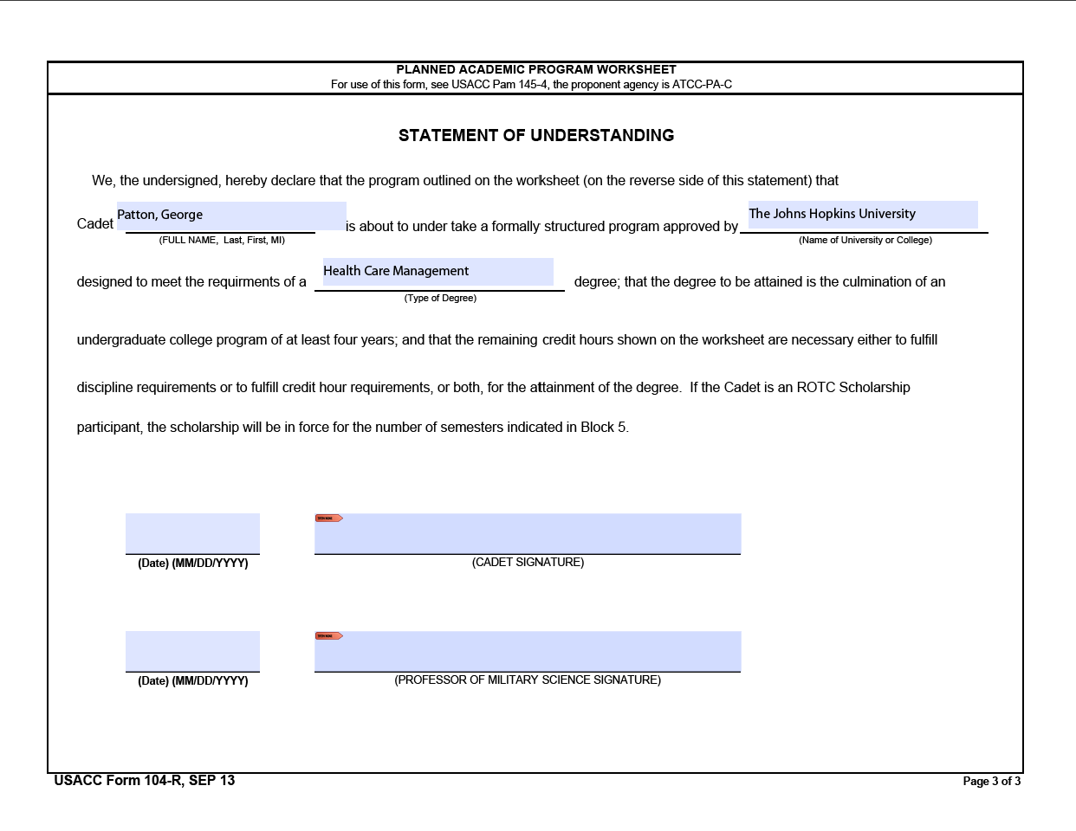
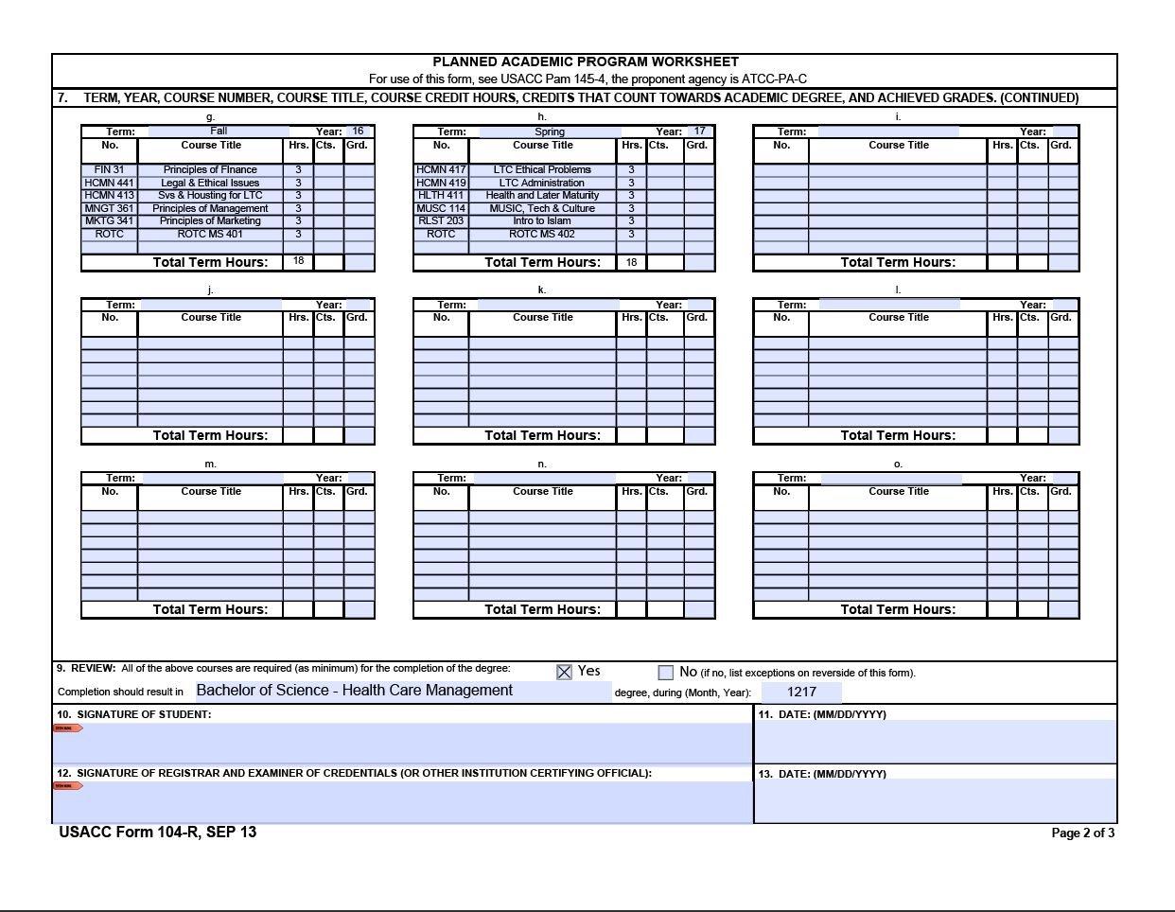
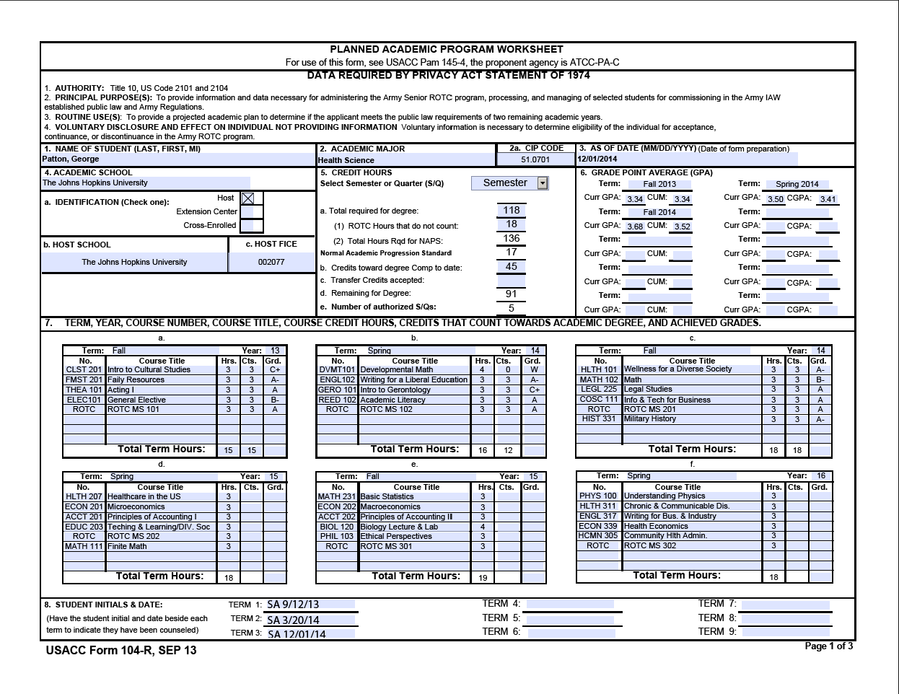
What is the 104-R?
A three page document that lays out a student’s academic plan. The 104-R is an ongoing document that is updated each semester as courses are completed as well as when schedules change. The 104-R is essential to mission management as it lays out the anticipated graduation date, is approved by a university official, and should clear up potential surprises in regards to failure to complete a military history course or graduate on time.
“Train to Lead”

Slide 4
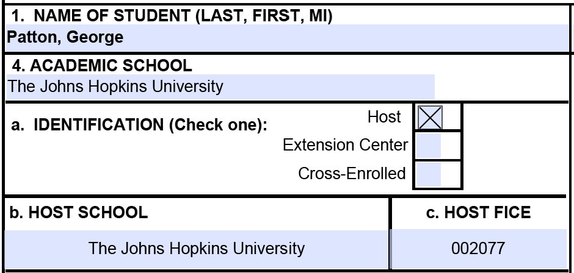
How to fill it out – pg. 1
1- Name
4- School
The Johns Hopkins University
University of Maryland – Baltimore County
Stevenson University
University of Baltimore
MICA
4a- Identification
TJHU is HOST
All others are CROSS-ENROLLED
4b- Host School is always The Johns Hopkins University
4c- Host Fice is 002077

Slide 5
How to fill it out – pg. 1
2- Academic Major
2a- CIP Code
Six digit number, this can be looked up at the following:
http://www.mhec.state.md.us/utilities/search_CIP.asp
5- Select “Semester Hours” from drop down menu
5a- Total required for degree – approximately 120, varies by degree
5a1- ROTC hours that don’t count (depends on school and degree)
(this includes all MS classes and Military History, however, the
Military History will normally cover a history requirement in most majors)
5a2- Total hours required for NAPS = the total required for the degree plus the ROTC courses that don’t count toward degree (5a + 5a1 = 5a2)
5b- Credits that have already been completed at the current institution
5c- any transfer credits accepted
5d- remaining credits for degree
5e- Number of authorized semesters remaining
This area is the most difficult to figure out and I usually do it last, after reviewing the actual courses and major requirements. Instructors need to review the course catalogues to determine what is required for each degree (5a), most majors require 120, STEM often requires more (130-140). The ROTC hours that don’t count (5a1) depends on how many “free electives” the major has. Criminal Justice often has many “free electives”, Nursing has none.

Slide 6
How to fill it out – pg. 1
3- As of Date
6- GPA – ensure you put the proper semester. This starts with the student’s first semester on campus, and does not include any work completed prior to attending (at a community college or previous school if they transferred).

Slide 7
How to fill it out – pg. 1
7- Term, Year, Course Number, Course Title, Credit Hours, Credits That Count Toward Degree, and Grade
This section should mirror their current transcripts, minus any transfer credits. It starts with their first semester on campus and ends at graduation. The example shows that this is an MSII student in the spring of their sophomore year – grades are shown for courses they already took, everything going forward is just the courses they plan to take. This will likely adjust somewhat and that’s okay, so long as they stay within the total semesters required for their degree plan. This section continues onto page 2, the typical student will use eight total semesters.
8- Student Initial and Date – this is when they were counseled by their instructor

Slide 8
How to fill it out – pg. 2
7- Continued from page 1
9- Degree awarded, including date
10/11- signature/date of student
12/13- signature/date of university official. This should be someone within their academic department.

Slide 9
How to fill it out – pg. 3
See example -

Slide 10
Further Explanation
(how to figure out section 5)
*
*Only the blue shaded numbers are fillable, the white are automatically populated.
This slide shows how to figure out section 5 and where all the numbers come from. Using the examples above, we have a Health Science Major from Towson. The student left their credit hours (Sec 5) blank so I’ll use section 7 to figure it out. Because the academic advisor signed off on this I’ll assume that this will in fact meet all requirements for a degree.
First I’ll add up every credit that was awarded already, and all credits planned. The student has already taken 45 credits after three semesters (7a, 7b, 7c), so that goes in 5b. They have 91 listed to take going forward (7d, 7e, 7f, 7g, 7h), so 5d must equal 91. Now I’ll put in 120 into 5a to see where that leaves me. I’ll adjust 5a from 120 up to about 130 in order to get 91 in 5d. If 5a must go over 130 then I need to get into the course catalogue and double check the student’s work.

