Slide 1
Strategies for responding critically to a text Class Session for Applications of Biological Concepts in Public Health March 14, 2023
Rebecca Wilbanks, PhD
Lecturer, University Writing Program
rwilban2@jhu.edu

Slide 2
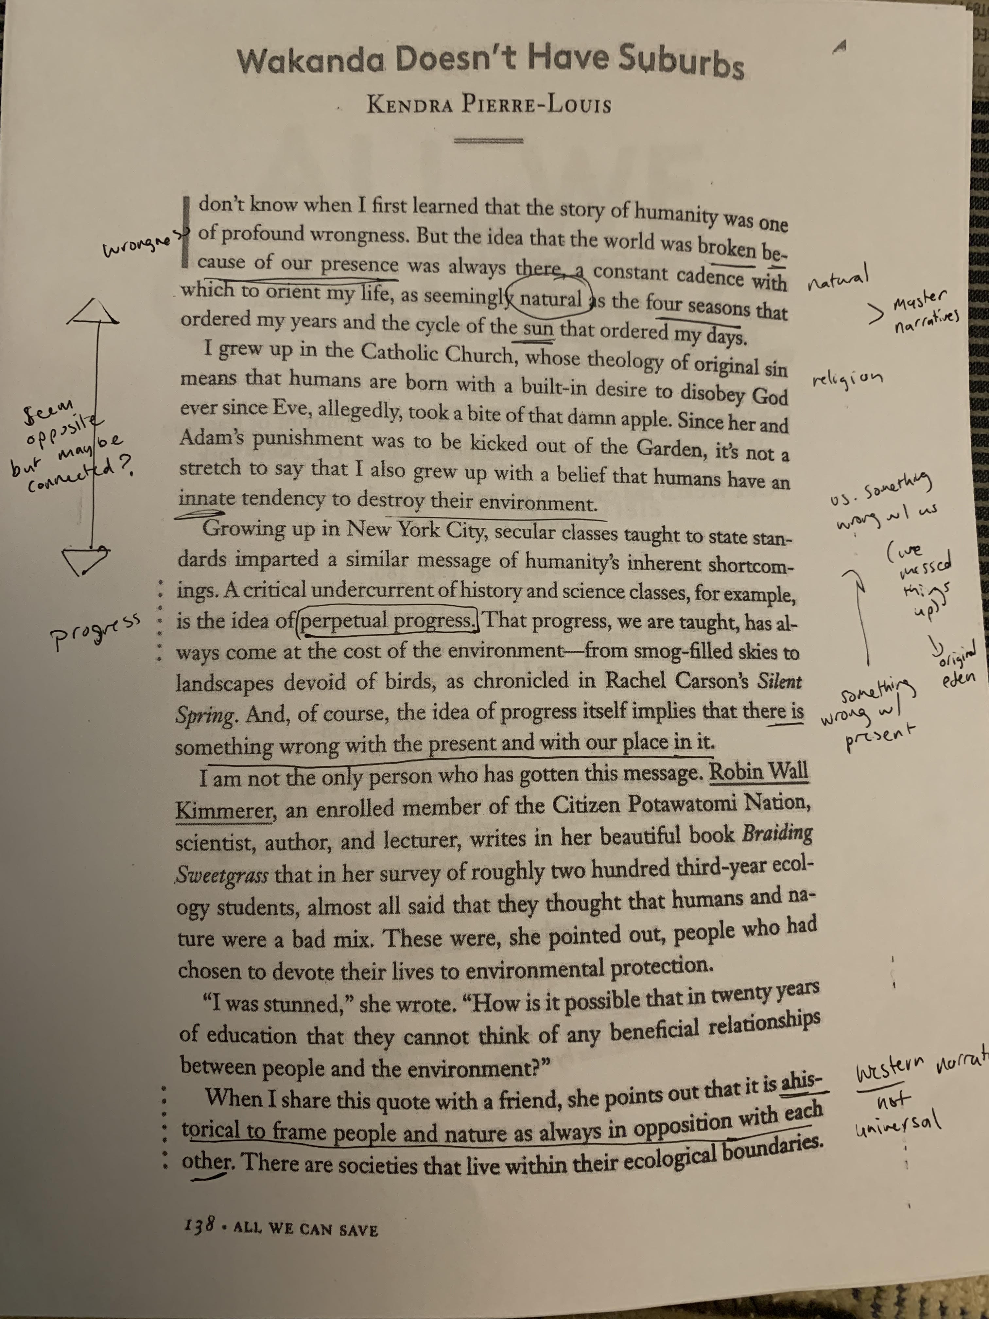
Good discussion questions start with annotations that record or highlight:
Gists of passages
Your reactions; places where you agree, want to challenge the author’s assertions, are surprised by something, etc.
Connections to other texts / ideas/ experiences
Questions, points of ambiguity
Seeming contradictions
Key words and sentences, striking language

Slide 3
Thoughts?
Pierre-Louis discusses the movie Avatar. What did you think of the film?

Slide 4
Thoughts?
The author notes that she “enjoys” and is a “fan” of many of the dystopian stories she discusses (139, 141), even as she finds their implications to be disturbing. Judging by their popularity, many other people enjoy them too. What makes dystopian fiction so pleasurable? Is there something about these narratives that makes them more fun than stories of humans living in balance with their environment?

Slide 5
Great discussion questions/ reading responses:
Make us think hard about the text
Have no obvious answer
May provide complementary perspectives or frameworks that help us see the author’s ideas in a new way
What else??

Slide 6
Analytical moves (Go inward)
Highlight an assumption of the author’s argument
Make an observation about the structure of the text. How does one part relate to another part, or to the overall argument?
Ask about something you found ambiguous or hard to understand
Make us think carefully about the evidence the author uses to support their thesis
Identify an apparent contradiction in the text
Highlight a striking or unexpected phrase and talk about its effect

Slide 7
Analogical and extending moves (Go outward)
Ask a comparative question about a related text or concept
Offer an example or experience that provides further support for the author’s claims, reframes them, or complicates them
Ask about an implication of the author’s argument: if this is true, then…?

Slide 8
Your turn
Share your discussion questions in groups. Which moves on the handout are your questions making? Work together to strengthen each question and generate a couple new ones using moves that you don’t have represented yet.
Do any of your questions make interesting moves that are not represented on the handout?
Each group will be asked to share their strongest question with the class!

